Slide 1
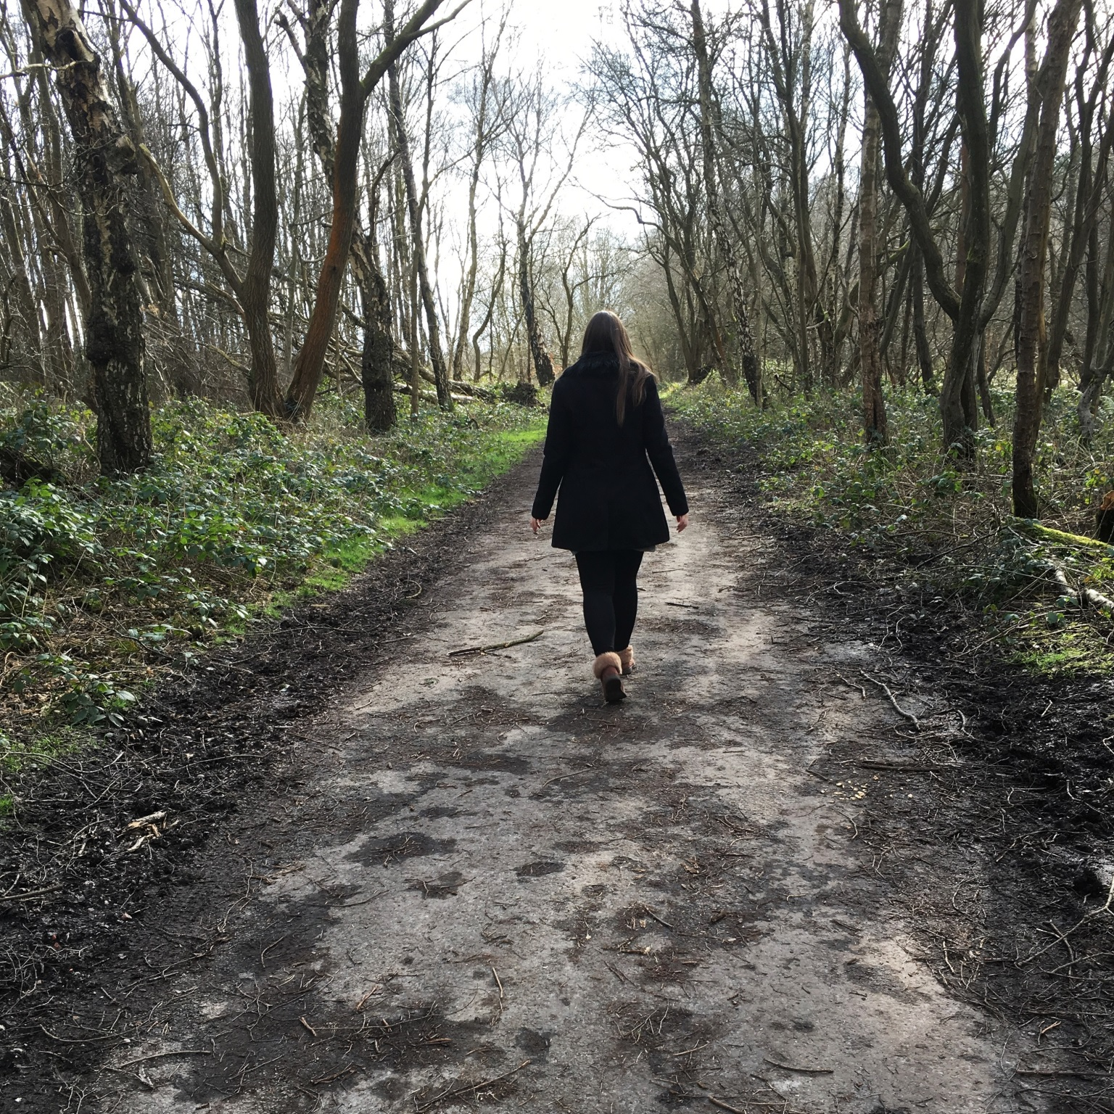
About Skills Example
Adele Dibble
Computer Science Graduate / Front end developer

Slide 2
Adele Dibble
Computer Science Graduate / Front end developer

Slide 3

About me:
Text here about me
Qualifications and skills

Slide 4
About me
Text in here about me
On mobile design (maybe lose the picture to have text bigger)

Slide 5
Examples of work
Then scrolling of images of screen shots of work – or an image just arty one with button
See examples

Slide 6
Examples of work
Then have a few images of work
See examples

